Slide 1
Protection

Slide 2
Goals of Protection
Obviously to prevent malicious misuse of the system by users or programs. See chapter 15 for a more thorough coverage of this goal.
To ensure that each shared resource is used only in accordance with system policies, which may be set either by system designers or by system administrators.
To ensure that errant programs cause the minimal amount of damage possible.
Note that protection systems only provide the mechanisms for enforcing policies and ensuring reliable systems. It is up to administrators and users to implement those mechanisms effectively.

Slide 3
Principles of Protection
The principle of least privilege dictates that programs, users, and systems be given just enough privileges to perform their tasks.
This ensures that failures do the least amount of harm and allow the least of harm to be done.
For example, if a program needs special privileges to perform a task, it is better to make it a SGID program with group ownership of "network" or "backup" or some other pseudo group, rather than SUID with root ownership. This limits the amount of damage that can occur if something goes wrong.

Slide 4
Domain of Protection
A computer can be viewed as a collection of processes and objects ( both HW & SW ).
The need to know principle states that a process should only have access to those objects it needs to accomplish its task, and furthermore only in the modes for which it needs access and only during the time frame when it needs access.
The modes available for a particular object may depend upon its type.

Slide 5
Domain Structure
A protection domain specifies the resources that a process may access.
Each domain defines a set of objects and the types of operations that may be invoked on each object.
An access right is the ability to execute an operation on an object.
A domain is defined as a set of < object, { access right set } > pairs, as shown below. Note that some domains may be disjoint while others overlap.

Slide 6
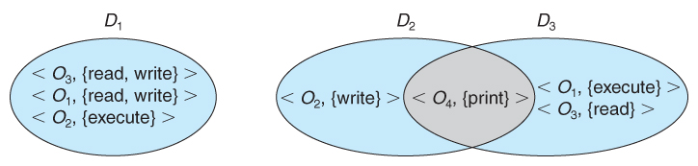
System with three protection domains.

Slide 7
An Example: UNIX
UNIX associates domains with users.
Certain programs operate with the SUID bit set, which effectively changes the user ID, and therefore the access domain, while the program is running. ( and similarly for the SGID bit. ) Unfortunately this has some potential for abuse.
An alternative used on some systems is to place privileged programs in special directories, so that they attain the identity of the directory owner when they run. This prevents crackers from placing SUID programs in random directories around the system.
Yet another alternative is to not allow the changing of ID at all. Instead, special privileged daemons are launched at boot time, and user processes send messages to these daemons when they need special tasks performed.

Slide 8
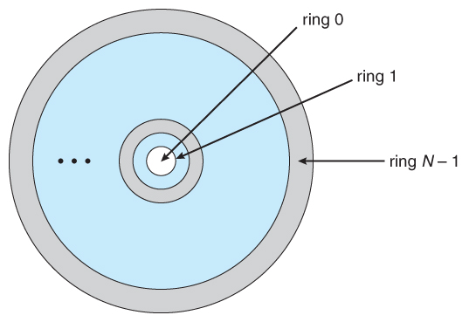
An Example: MULTICS

Slide 9
Rings are numbered from 0 to 7, with outer rings having a subset of the privileges of the inner rings.
Each file is a memory segment, and each segment description includes an entry that indicates the ring number associated with that segment, as well as read, write, and execute privileges.
Each process runs in a ring, according to the current-ring-number, a counter associated with each process.
A process operating in one ring can only access segments associated with higher ( farther out ) rings, and then only according to the access bits. Processes cannot access segments associated with lower rings.
Domain switching is achieved by a process in one ring calling upon a process operating in a lower ring, which is controlled by several factors stored with each segment descriptor:
An access bracket, defined by integers b1 <= b2.
A limit b3 > b2
A list of gates, identifying the entry points at which the segments may be called.
If a process operating in ring i calls a segment whose bracket is such that b1 <= i <= b2, then the call succeeds and the process remains in ring i.
Otherwise a trap to the OS occurs, and is handled as follows:
If i < b1, then the call is allowed, because we are transferring to a procedure with fewer privileges. However if any of the parameters being passed are of segments below b1, then they must be copied to an area accessible by the called procedure.
If i > b2, then the call is allowed only if i <= b3 and the call is directed to one of the entries on the list of gates.
Overall this approach is more complex and less efficient than other protection schemes.

Slide 10
Access Matrix
The model of protection that we have been discussing can be viewed as an access matrix, in which columns represent different system resources and rows represent different protection domains. Entries within the matrix indicate what access that domain has to that resource.

Slide 11
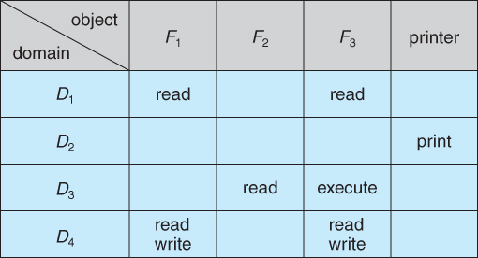
Access Matrix

Slide 12
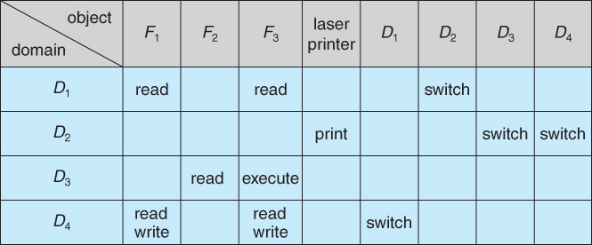
DOMAIN SWITCH

Slide 13
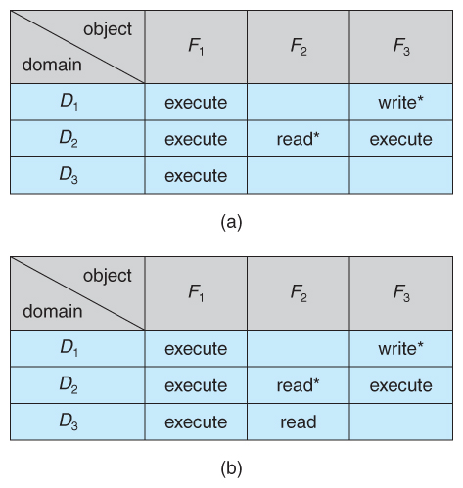
copy rights is denoted by an asterisk, If the asterisk is removed from the original access right, then the right is transferred, rather than being copied. This may be termed a transfer right as opposed to a copy right.

Slide 14
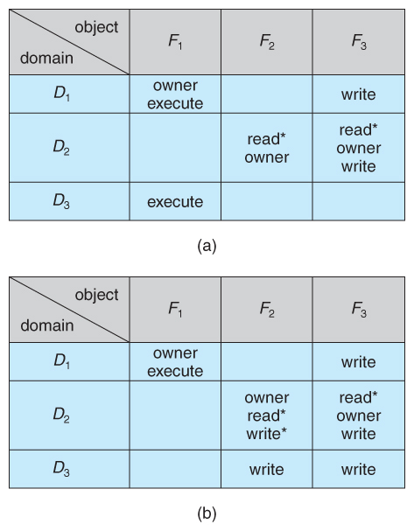
owner right adds the privilege of adding new rights or removing existing one

Slide 15
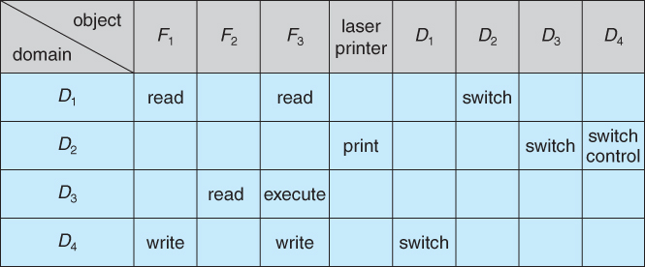
The addition of control rights, which only apply to domain objects, allow a process operating in one domain to affect the rights available in other domains

Slide 16
Implementation of Access Matrix
Global Table
Access Lists for Objects
Capability Lists for Domains
A Lock-Key Mechanism

Slide 17
Global Table
The simplest approach is one big global table with < domain, object, rights > entries.
Unfortunately this table is very large ( even if sparse ) and so cannot be kept in memory ( without invoking virtual memory techniques. )
There is also no good way to specify groupings - If everyone has access to some resource, then it still needs a separate entry for every domain.

Slide 18
Access Lists for Objects
Each column of the table can be kept as a list of the access rights for that particular object, discarding blank entries.
For efficiency a separate list of default access rights can also be kept, and checked first.

Slide 19
Capability Lists for Domains
In a similar fashion, each row of the table can be kept as a list of the capabilities of that domain.
Capability lists are associated with each domain, but not directly accessible by the domain or any user process.
Capability lists are themselves protected resources, distinguished from other data in one of two ways:
A tag, possibly hardware implemented, distinguishing this special type of data. ( other types may be floats, pointers, booleans, etc. )
The address space for a program may be split into multiple segments, at least one of which is inaccessible by the program itself, and used by the operating system for maintaining the process's access right capability list.

Slide 20
A Lock-Key Mechanism
Each resource has a list of unique bit patterns, termed locks.
Each domain has its list of unique bit patterns, termed keys.
Access is granted if one of the domain's keys fits one of the resource's locks.
Again, a process is not allowed to modify its keys.
Comparison
Each method here has certain advantages or disadvantages, depending on the situation and task at hand.
Many systems employ some combination of the listed methods.

Slide 21
Access Control– Solaris
Role-Based Access Control, RBAC, assigns privileges to users, programs, or roles as appropriate, where "privileges" refer to the right to call certain system calls, or to use certain parameters with those calls.
RBAC supports the principle of least privilege, and reduces the susceptibility to abuse as opposed to SUID or SGID programs.

Slide 22
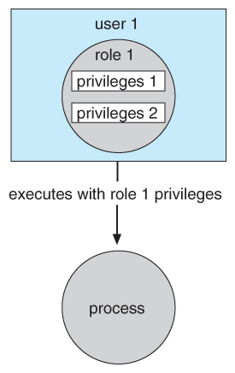
Role-based access control in Solaris 10

Slide 23
Revocation of Access Rights
The need to revoke access rights dynamically raises several questions:
Immediate versus delayed - If delayed, can we determine when the revocation will take place?
Selective versus general - Does revocation of an access right to an object affect all users who have that right, or only some users?
Partial versus total - Can a subset of rights for an object be revoked, or are all rights revoked at once?
Temporary versus permanent - If rights are revoked, is there a mechanism for processes to re-acquire some or all of the revoked rights?

Slide 24
With an access list scheme revocation is easy, immediate, and can be selective, general, partial, total, temporary, or permanent, as desired.
With capabilities lists the problem is more complicated because access rights are distributed throughout the system.

Slide 25
A few schemes that have been developed include:
Reacquisition - Capabilities are periodically revoked from each domain, which must then re-acquire them.
Back-pointers - A list of pointers is maintained from each object to each capability which is held for that object.
Indirection - Capabilities point to an entry in a global table rather than to the object. Access rights can be revoked by changing or invalidating the table entry, which may affect multiple processes, which must then re-acquire access rights to continue.
Keys - A unique bit pattern is associated with each capability when created, which can be neither inspected nor modified by the process.
A master key is associated with each object.
When a capability is created, its key is set to the object's master key.
As long as the capability's key matches the object's key, then the capabilities remain valid.
The object master key can be changed with the set-key command, thereby invalidating all current capabilities.
More flexibility can be added to this scheme by implementing a list of keys for each object, possibly in a global table.

